Slide 1
Data connect @ California state university northridge
Sherrie Hixon & Nerces Kazandjian
January 15, 2021
Questions regarding this presentation can be sent to: Sherrie.hixon@csun.edu

Slide 2
Csun dashboards
Custom reports in Data Connect for proposals, awards, and projects
Excel files cleaned and used as data source in Tableau
Filters added for college, award year, sponsor, sponsor type, admin unit, and faculty rank
Sheets created for FY, sponsor type, college, and faculty rank
Tool tips provide greater level of detail
Overall design is consistent with institutional colors
Published to CSUN’s Tableau Server
Link to website: https://www.csun.edu/research-sponsored-programs/dashboards

Slide 3
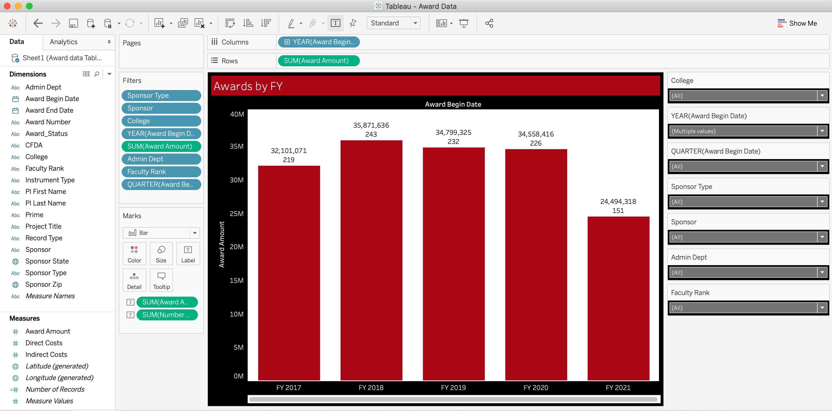

Slide 4
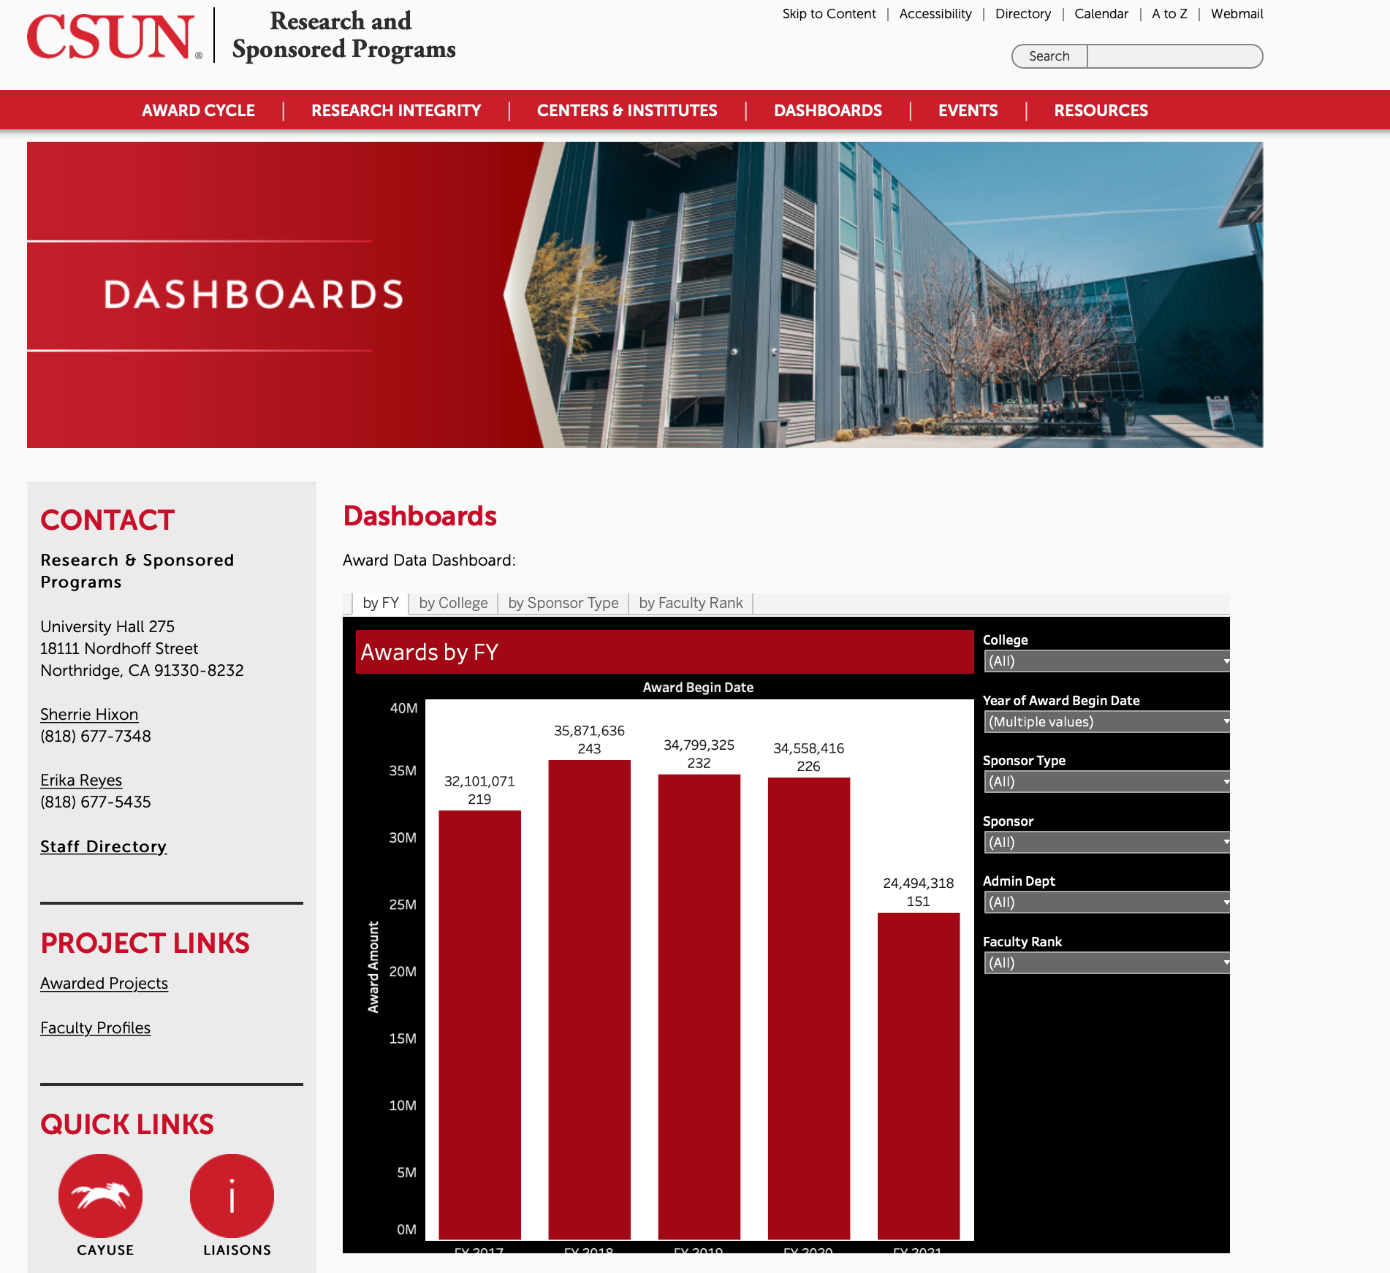

Slide 5
Faculty Scholarship
Awarded projects featured on CSUN’s Scholarship application
Email template from Accounts in SP used to alert PI of their project being published on the site
Settings for stealth, institutional access, and public showcase
Faculty add their research themes to each project
Ability to recruit students
Search functionality by keywords in titles and abstracts, research interests and themes, and members (PIs)
Link to website: https://academics.csun.edu//faculty/scholarship/project

Slide 6
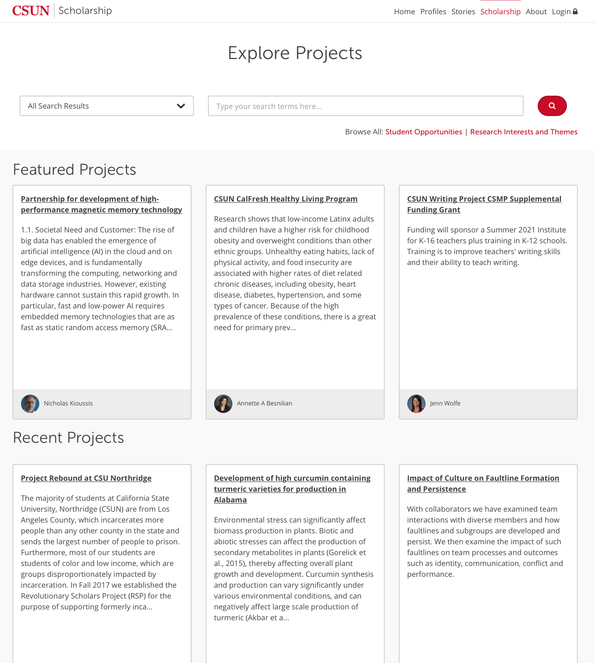

Slide 7
META+LAB
The Matador Emerging Technology and Arts Lab (META+LAB) is an extension of the academic program that functions as a collaborative development startup.
Interdisciplinary student development teams guided by staff and faculty mentors work directly with the CSUN campus and community on meaningful projects.
Students are given the freedom to engage in experimental projects with emerging technology and design principles that will propel their forward progress as creative and critical thinkers.

Slide 8
PRODUCT DESIGN PHILOSOPHY
Web Applications
Establish consistent workflow and processes across different units
Use technology and design to make improvements where possible
Reduce data inconsistency and unnecessary redundancy
Web Service APIs
Abstract data presentation away from database structure
Simplify and promote access to institutional data for developers

Slide 9
FACULTY SCHOLARSHIP
Scholarship Data
Data exported from Cayuse as multiple tables
Table data regularly synced to application server
Synced data re-organized to fit into existing MySQL database structure
Scholarship Application
User-friendly presentation using campus branding
Incorporate data from other applications
Export data using API web services

